Slide 1
LIBRARY MANAGEMENT SYSTEM

Slide 2
AIM OF THE PROJECT
A college library management is a project that manages and stores books information electronically according to students needs. The system helps both students and library manager to keep a constant track of all the books available in the library.
It allows both the admin and the student to search for the desired book. It becomes necessary for colleges to keep a continuous check on the books issued and returned and even calculate fine.
This task if carried out manually will be tedious and includes chances of mistakes.
These errors are avoided by allowing the system to keep track of information such as issue date, last date to return the book and even fine information and thus there is no need to keep manual track of this information which thereby avoids chances of mistakes.
Thus this system reduces manual work to a great extent allows smooth flow of library activities by removing chances of errors in the details.

Slide 3
OBJECTIVE OF THIS PROJECT
This project system was highly recommended due to the rapid increase of computer related tools in the industry.
With this proposed system features and functions of the online book shop and the e-library that will be able to accommodate more reliably consistent and faster in providing a better service to the users.

Slide 4

SOFTWARE AND HARDWARE REQUIREMENTS
HARDWARE REQUIREMENTS:
Processor : intel 3
Motherboard : intel 915gvsr chipset board
Ram : 4 gb ddr2 ram
Hard disk drive : 160 gb
SOFTWARE REQUIREMENTS:
Front end : html5, css3, bootstrap
Back end : php, mysql
Control end : angular java script
PHP TOOLS:
xampp-win32-5.5.19-0-VC11
ANDROID TOOLS:
Android Emulator
xampp-win32-5.5.19-0-VC11
Android Studio

Slide 5
EXISTING SYSTEM
Time and access can be obstacles to library research.
Readers must get to the library during library hours, which may not be convenient. They also may need to stay in the library for a long time to ensure they have exhausted all resources.
Some resources may not be available for checkout, which means the student must stay in the library to use them.
And those that do circulate may be checked out by others and unavailable to anyone else.

Slide 6
DISADVANTAGES OF EXISTING SYSTEM
Lack of privacy​
Risk in the management of the data.​
Less Security​
Low co-ordination between ​
Less User-friendly​
Accuracy not guaranteed​
Not in reach of distant users.
There is no storage and automation if users have some enquiry.

Slide 7
PROPOSED SYSTEM
Proposed system is an automated Library Management System. Through our software user can add books, search books, renewal, update information, edit information, and return books in quick time. Our proposed system has the following advantages.
Developed a well-organized book issue and searching system. Produced a well-designed and functioning system in accordance to the needs and wants of the borrowers.
Minimized the task and the effort being performed by both the owners and borrowers.
Provided the school and the students a well-organize and well-presented reports.
. User friendly interface
. Fast access to database
. Less error
. More Storage Capacity
. Search facility
. Look and Feel Environment
. Quick transaction

Slide 8
ADVANTAGES OF PROPOSED SYSTEM
The system excludes the use of paper work by managing all the book information electronically.
Admin can keep updating the system by providing the new books arrival in system and their availability thus students need not to go to library for issuing purpose.
The system has books well organized and systematically arranged in different categories in the system so that user can easily search and find the book.
Thus, it saves human efforts and resources.

Slide 9
MODULE LIST
PUBLIC/ USER
Login
Register
Search Book
My Borrow History Book
  Issue Date, Exp Date
Check Fine
Search material ( year, semester wise )
Download material
My profile

Slide 10
MODULE LIST
ADMIN
Login
Add Book
Update/Delete Book
Issue Book for student
Return Book Status
Make Fine
Update material ( year, semester wise )
View material

Slide 11
USECASE DIAGRAMS
USER/ PUBLIC

Slide 12
USECASE DIAGRAMS
ADMIN

Slide 13
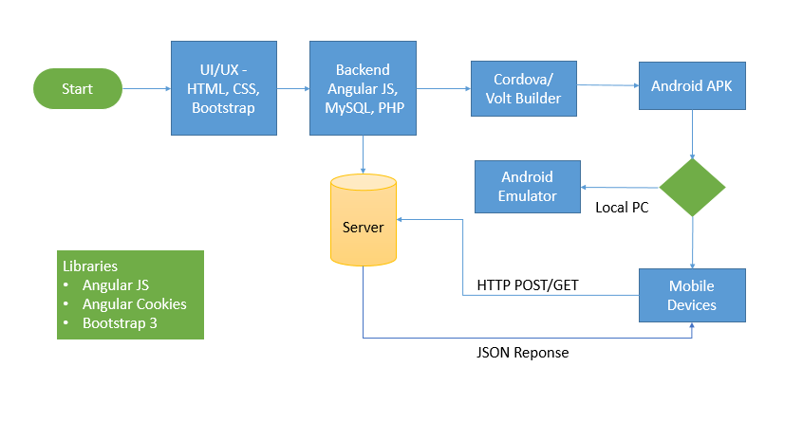
WORK FLOW DIAGRAM FOR ANDROID

Slide 14
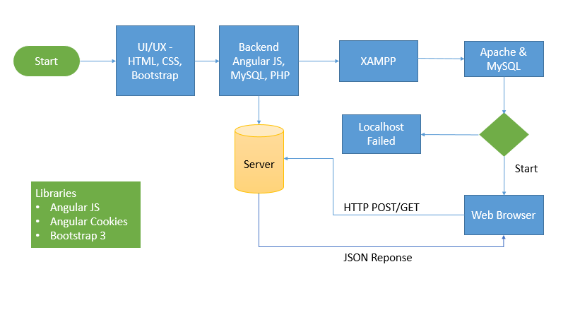
WORK FLOW DIAGRAM FOR WEB APPLICATION

Slide 15
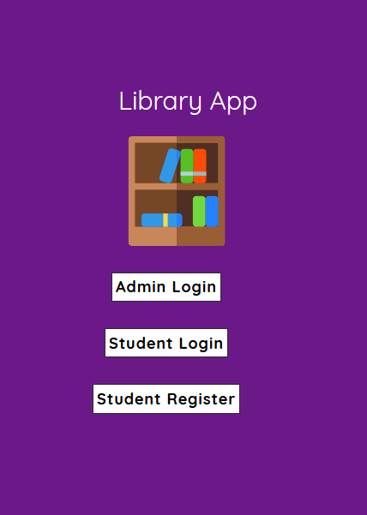
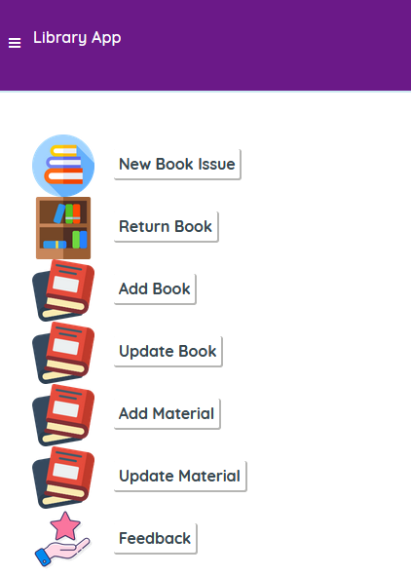
SCREENSHOTS

Slide 16
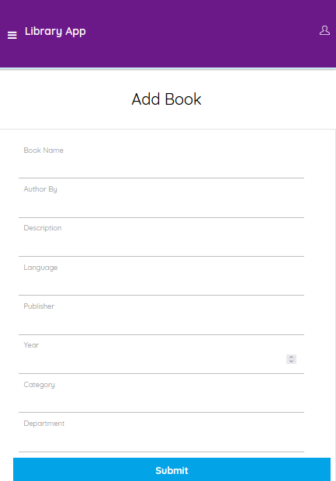
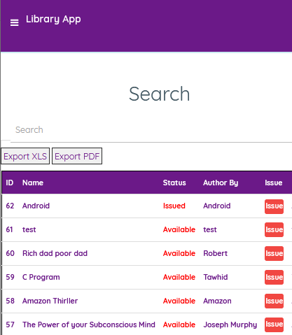

Slide 17
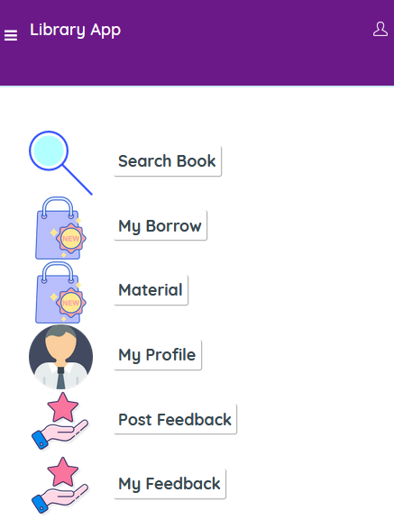
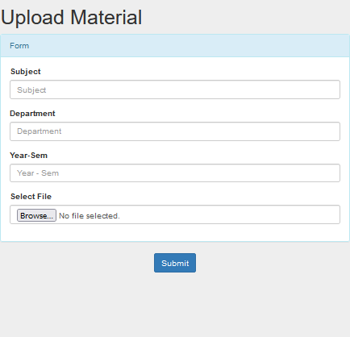

Slide 18
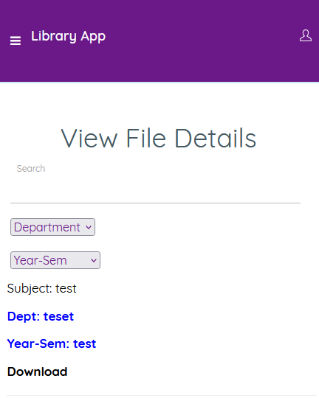
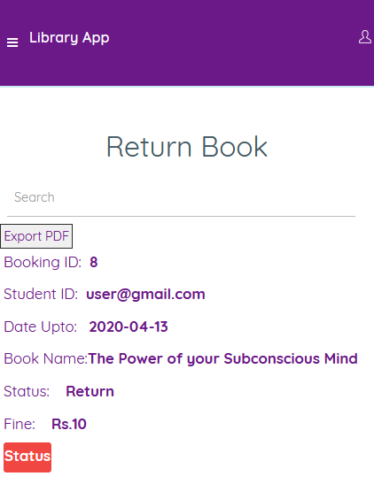

Slide 19
CONCLUSION
Hence we have designed the project to provide the user with easy navigation, retrieval of data and necessary feedback as much as possible.
In this project, the user is provided with an online system that can be used to issue and return books in library management online. It should be convenient for the student to view the contents of their status and to be able to return or add books to their account.
The Online library System provides a number of features that are designed to make the student more comfortable.
This project helps in understanding the creation of an interaction and the transparency between the student and the librarian of the books through the system.

Slide 20
FUTURE ENHANCEMENT
In Future work, This application to develop a cross platforms like IOS, etc.
In adding the more features of online library management system to develop access with user’s flexibility.
To authenticate the users based on the system users list which is maintained by the operating system
To restrict the usage of all files by the users based on their privileges on the system

Slide 21
REFERNECES
J. Thirumurugan, G. Kartheeswaran, M. Vinoth, M. Vishwanathan, "Line following robot for library inventory management system", Int. Conf. on Emerging Trends in Robotics and Communication Technologies, Dec. 2010.
Jesus M. Gomez, De Gabriel, Anthony Mandow, Jesus Fernandez Lozano, Alfonso J. Garcia-Cerezo, "Using LEGO NXT Mobile Robots with LabVIEW for Undergraduate Courses on Mechatronics", IEEE Trans. on Education, vol. 54, no. 1, Feb. 2011.
Jesus Manuel, Anthony Mandow, Jesus Fernandez Lozano, Alfonso Garcia Cerezo, Gomez de Gabriel, "Mobile Robot Lab Project toIntroduce Engineering Students to Fault Diagnosis in Mechatronic Systems", IEEE Trans. on Education, vol. 28, no. 3, Aug. 2015.
Colin Rennie, Rahul Shome, Kostas E. Bekris, Alberto F. De Souza, "A dataset for improved RGBD- Based object detection and pose estimation for warehouse pick and place", IEEE Robotics and Automation Letters, vol. 1, no. 2, July 2016.
Rahul S. Pol, Sagar Giri, Aditya Ravishankar, Varsha Ghode, "LabVIEW Based Four DoF Robotic arm", IEEE, 2016.

